Slide 1


Group Seven Imperial Credit Predictions by: Savannah Jones, Megan Toale, Gabby Doty, Katie Bardwell
Notes:
We recommend entering presentation mode.

Slide 2
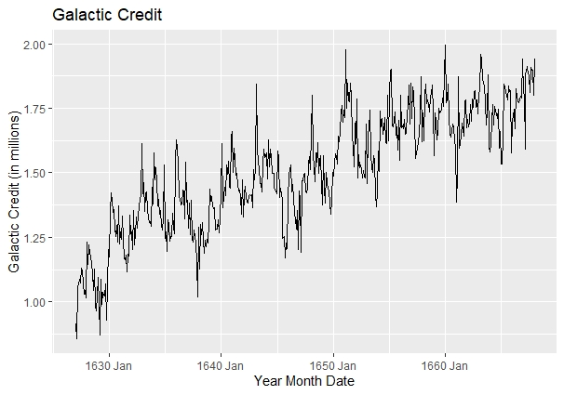


Displays historical credit value
Displays upward trend
No seasonal patterns
Predictions have no seasonal guide

Slide 3
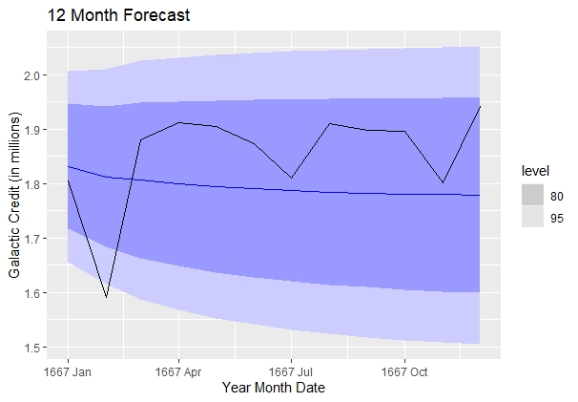
Relies heavily on the mean
Hence the line is nearly straight
Lack of seasonal pattern
Inability to predict or trust trend

